Slide 1
Machine Learning Semester Project
Group Member:
Name: Hassan Mahmood
Roll No: SP20-BCS-114
Name: Muhammad Talha
Roll No: FA20-BCS-007
Submitted To:
Name: Sir Zeeshan Gilani

Slide 2
Potato Plant Disease Detection
Three class Classification Problem
Machine Learning Project

Slide 3
Problem Statement
Farmers faced economic Lose due to various Diseases caused to potato such as
Early blight and Late Blight.
Also, way of treating both disease are also different.
So, it’s necessary to detect these diseases accurately to treat them on time.
It’s a Three Class Classification Problem for detection of Potato Disease. Classes as Follows
Early blight
Late blight
Healthy Leaves
Machine Learning Project

Slide 4
Solution
As Classification Problem, so using Convolution Neural Network (CNN).
As Images of potato leaf dataset required, so using a annotated dataset from Kaggle.
https://www.kaggle.com/datasets/emmarex/plantdisease
Data Augmentation will be Applied for better Learning.
CNN will be trained on dataset and Adam will be used as optimizer.
After training model, it will save in .h5 which contain all the parameters,
Just need to use it for Classification
Machine Learning Project

Slide 5
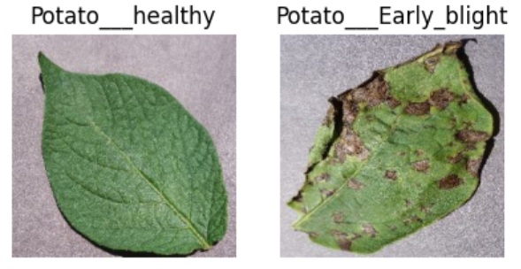
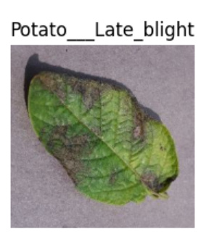
Plant Village Dataset
We uses Plant Village Dataset, which is multiple classes dataset of different plants leaves, we take classes related to Potato.
Total 2152 Images and Early_blight and Late_blight class have 1000 images and healthy class have 152 images
All images are RGB and have size 256 x 256 x 3.
Machine Learning Project

Slide 6
Project Working
Machine Learning Project

Slide 7
Data Processing and Splitting
Uses tensorflow.Keras for data Processing, Augmentation and Training.
As Data is already very clean and annotated and all images are in 256 x 256 x 3.
Define the Batch Size to 32, which is Standard for efficient training. Total 68 Batches having Shuffle Images.
Data Augmentation is applied in form of RandomFlip and RandomRotation.
Data Splitting is done as 80% Training, 10% Validation and 10% Testing.
Machine Learning Project

Slide 8
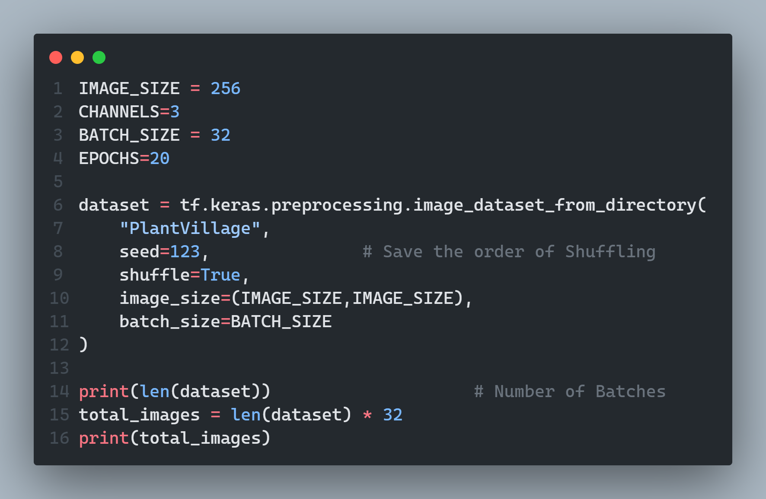
Data Loading into Batches
Machine Learning Project

Slide 9
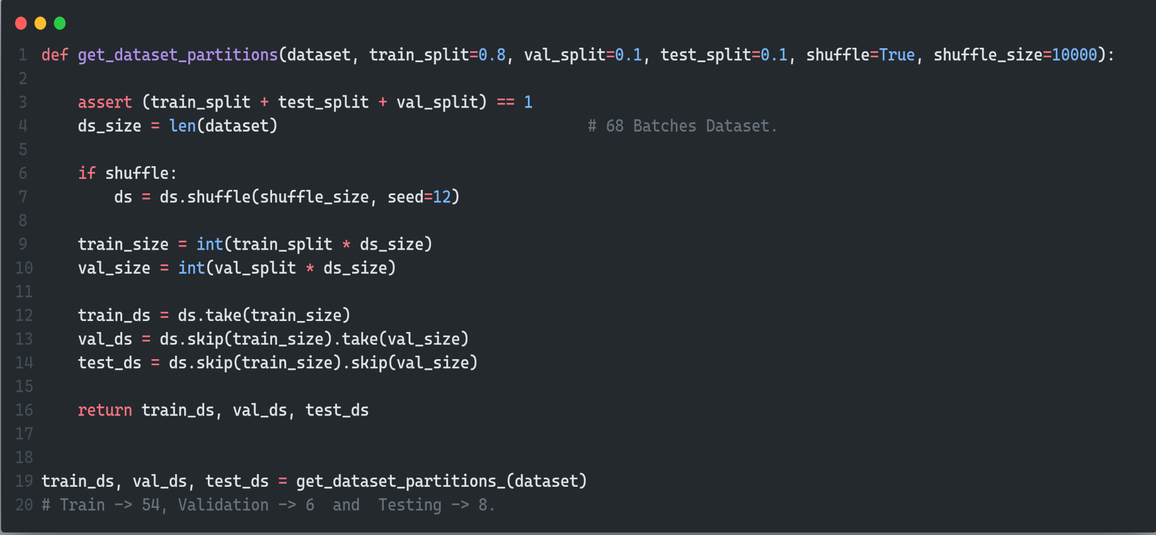
Splitting Dataset
80% for Training and 10% for Validation and 10% for Testing.
Machine Learning Project

Slide 10
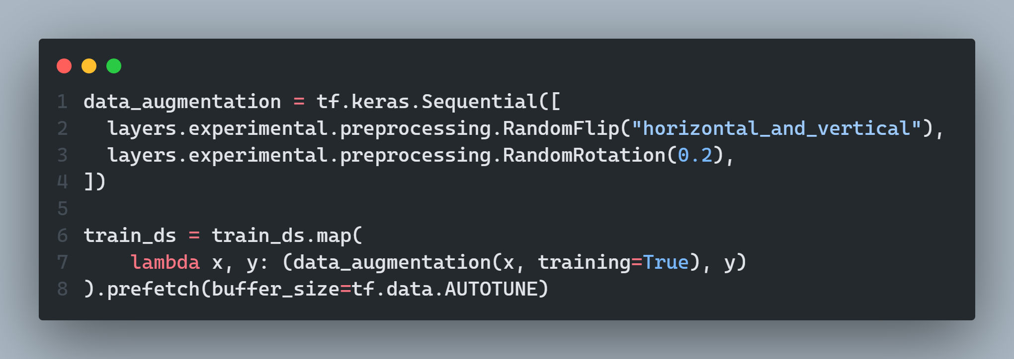
Data Augmentation
Machine Learning Project

Slide 11
Model Training (CNN)
As CNN is used as our model.
Passing Images to CNN in form of Batches, Input size as (32, 256, 256, 3)
Total 6 layers of Convolution is Used in Our Model. Filter at each Layer (3 x 3)
Max Pooling of (2 x 2)
Activation Function is Relu at each layer and softmax at output.
Total 183747 parameter to be train in our Neural Network.
Machine Learning Project

Slide 12
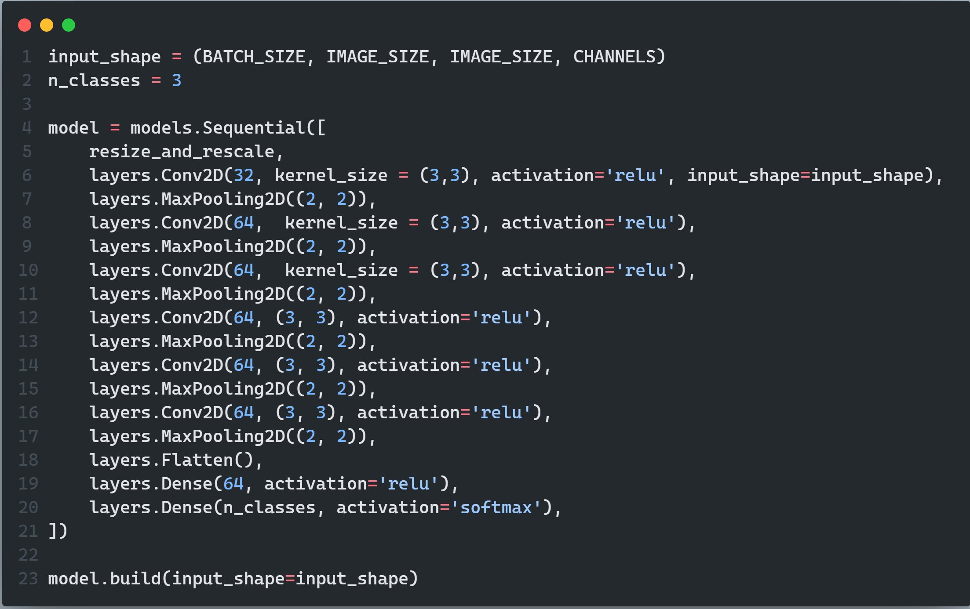

Slide 13
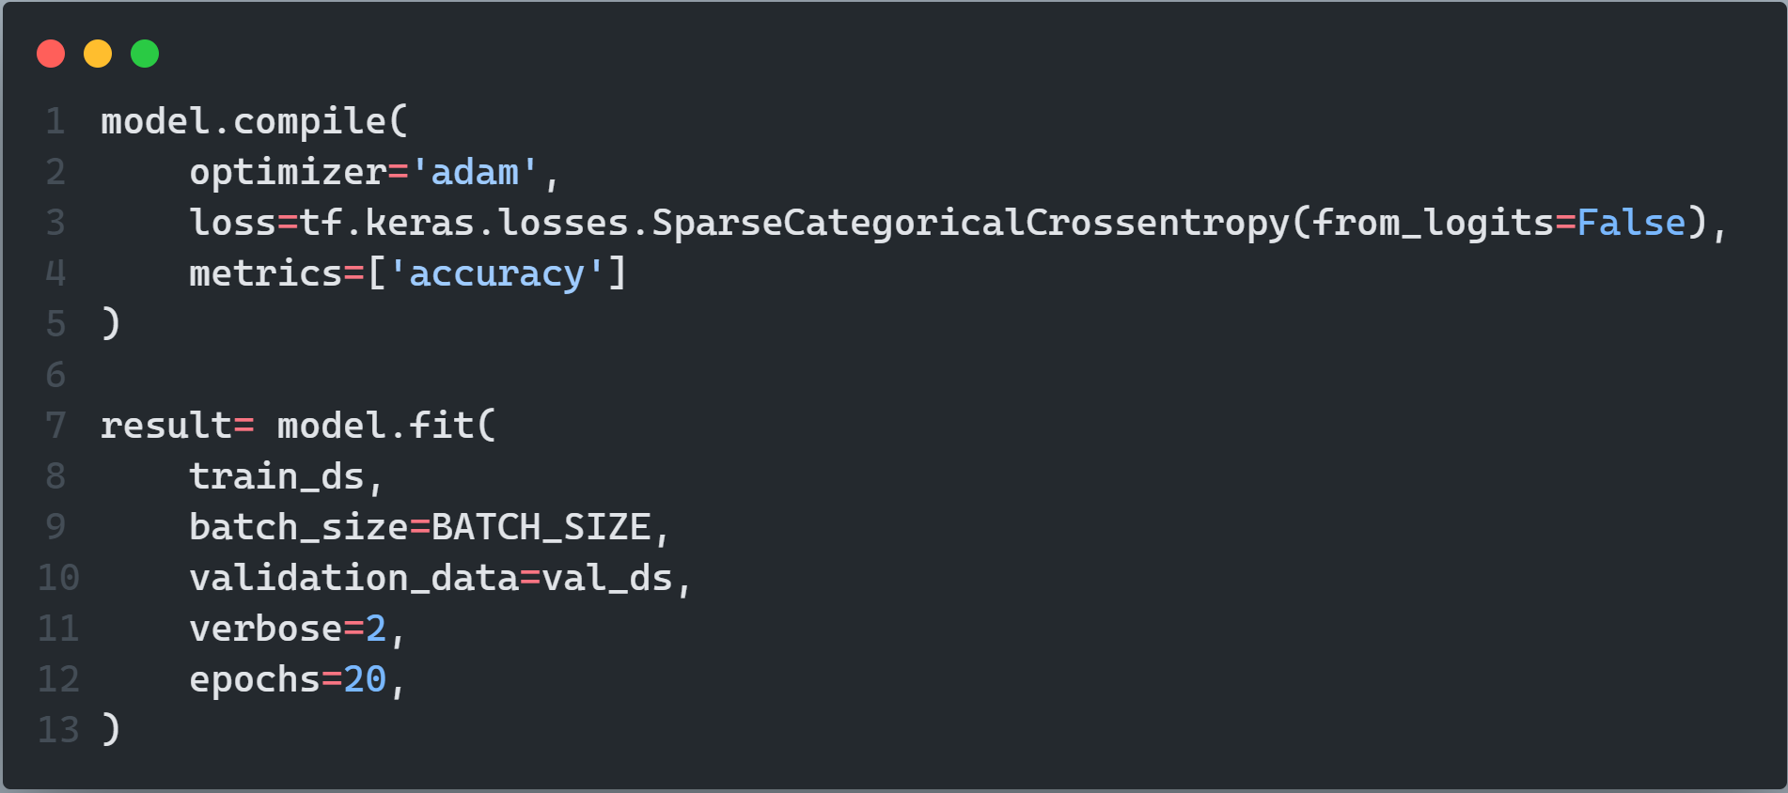
Compiling and Training Model
At 20 Epochs Training, Accuracy = 0.97, loss = 0.06. Val-Accuracy = 0.96, Val-loss = 0.06
Machine Learning Project

Slide 14
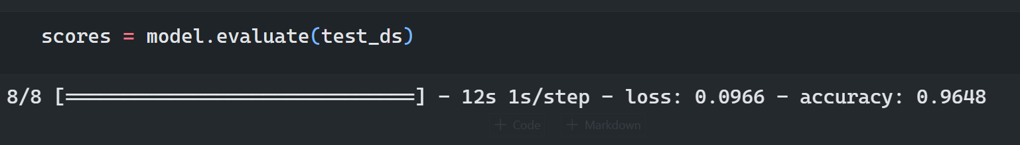
Model Evaluation on Test data

Slide 15
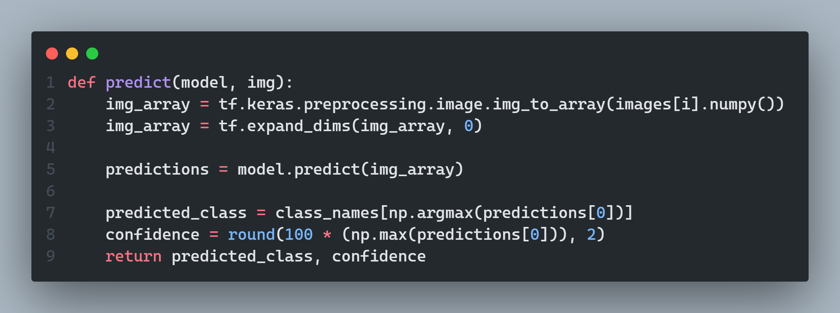
Prediction on Testing Data
Machine Learning Project

Slide 16
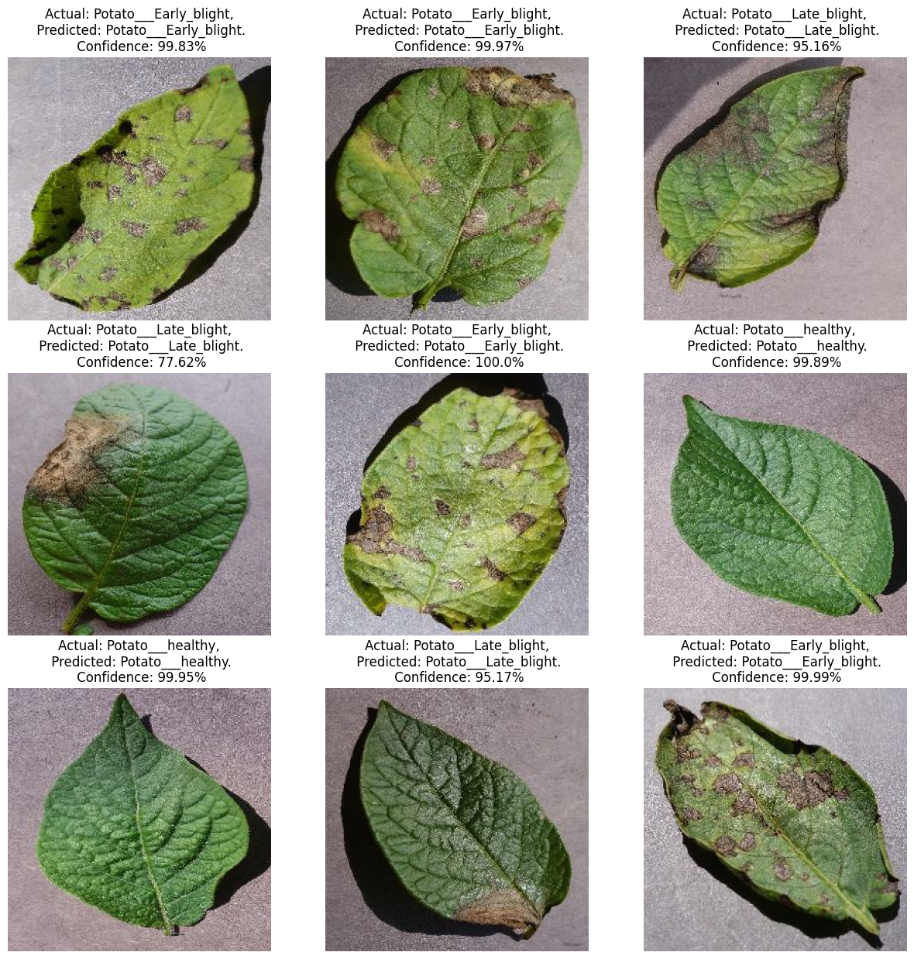
Machine Learning Project

Slide 17
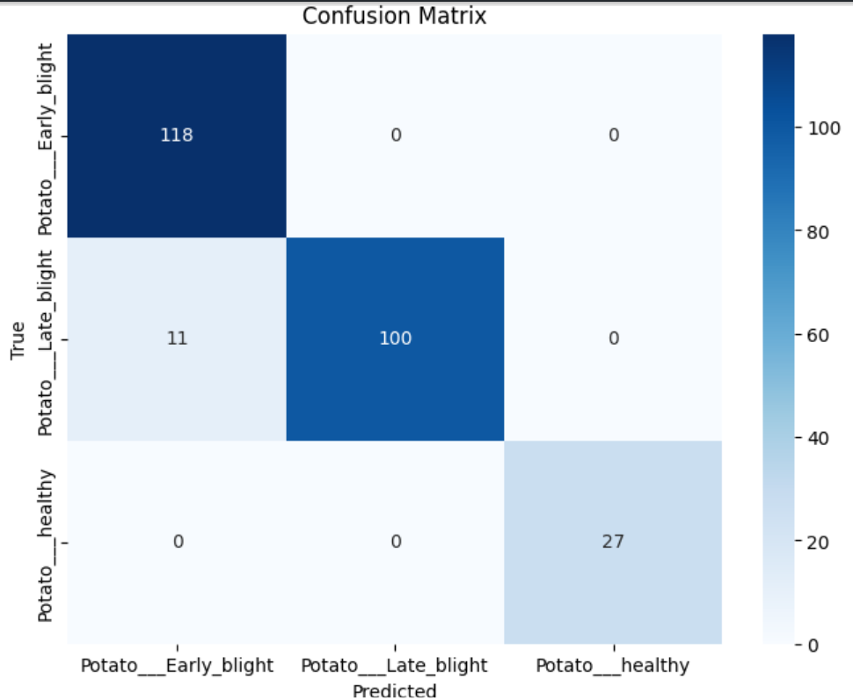
Confusion Matrix
Machine Learning Project

Slide 18
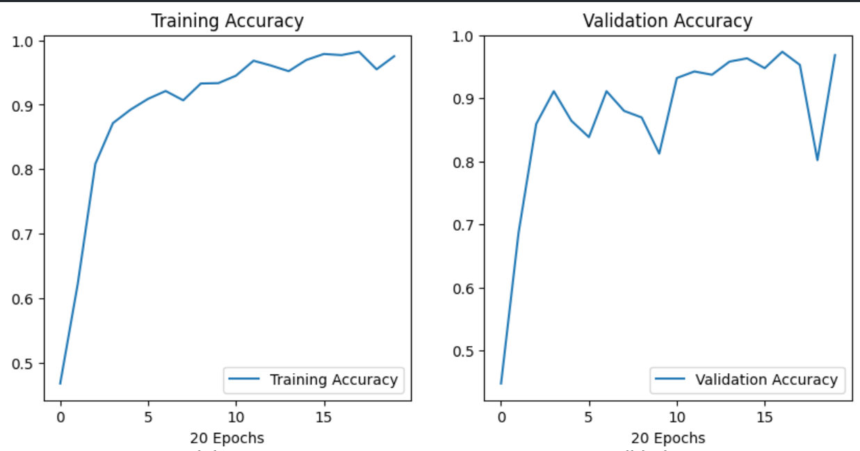
Accuracy and Loss Graph
Machine Learning Project

Slide 19
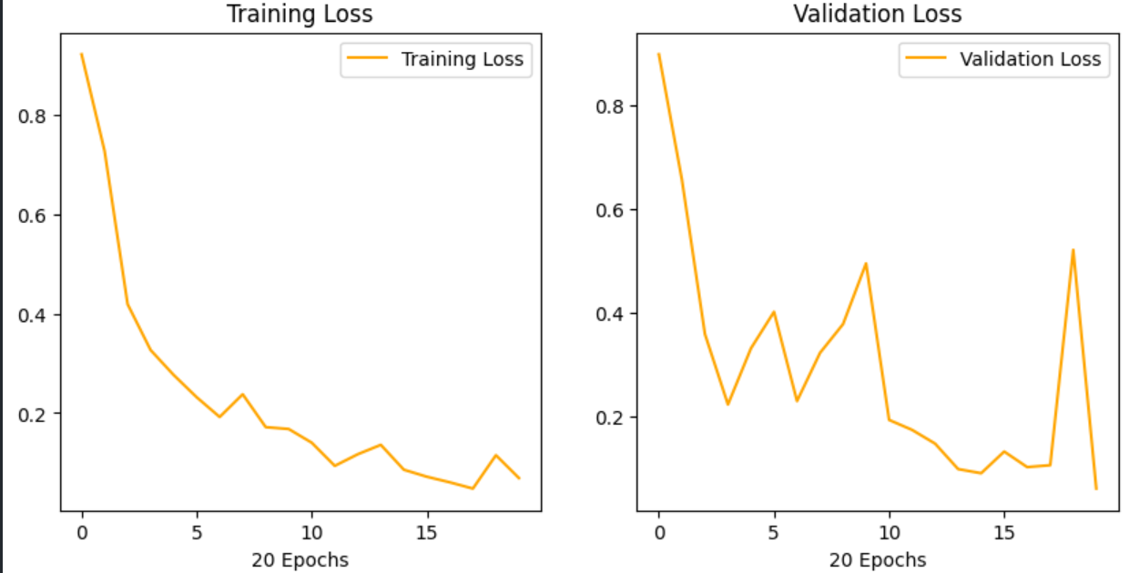
Accuracy and Loss Graph
Machine Learning Project

